Slide 1
PYTHON
This PPT is made for an individual who is willing to learn programming or want to enter in programming /coding world. This is beginner friendly ppt. and it helps an individual to learn PYTHON programming easily and effectively.
Note : When someone follow this ppt. he or she must do DAILY PRACTICE TO CODE .
shubham15362 @gamil.com
Shubham Patidar
This is made by Me (2021).
When I am in my 1st Year (2nd SEM.) of B.Tech(CSE) Degree. I got oppourtunity to taught the student of Grade 11th and 12th as “A PYTHON TUTOR” at School

Slide 2
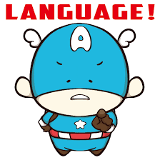

What is language ????
The principal method of human communication, consisting of words used in a structured and conventional way and conveyed by speech, writing, or gesture

Slide 3


???????????????
HEY ! HELLO !!

Slide 4


Tell the compter to say HELLO when I say hello
OK sir
Hey…. I order you. Say HELLO after my master says HELLO
PROGRAMMING LANGUAGE
PROGRAMMer

Slide 5
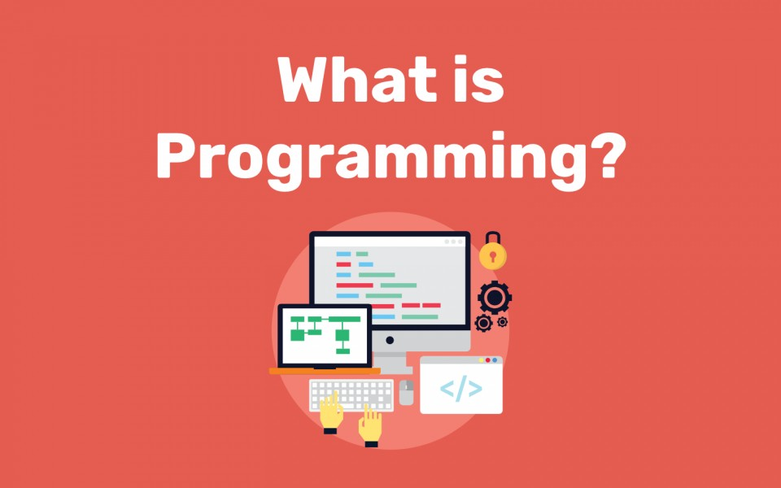
A programming language is a computer language that is used by programmers (developers) to communicate with computers.
It is a set of instructions written in any specific language ( C, C++, Java, Python) to perform a specific task.

Slide 6
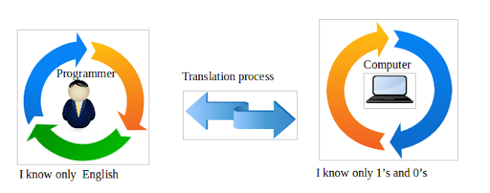
WHAT IS BINARY ?
How computer and programmer interact ?
“Hello”
Machine language is a low-level programming language that generally consists entirely of numbers.
Binary code is basically any information represented by a sequence of 1s and 0s.
Assembly language
Binary code
0110100001100101011011000110110001101111

Slide 7

WHY LEARN programming ?
Attractive Salary:
Multiple Career Opportunities:
Develop Problem-Solving and Logical Skill:
Develop Interpersonal Skills:
Technologies Are Ruling the World:
Coding is Creativity:
Understanding of Both Sides of the Equation in Business:
Empowering and Life-Changing Experience:
Self interest:

Slide 8
PYTHON
BY: SHUBHAM PATIDAR

Slide 9

WHAT IS PYTHON ?
Python is high-level programming language
which is :
Interpreted: Python is processed at runtime by the interpreter.
Interactive: You can use a Python prompt and interact with the interpreter directly to write your programs.
Object-Oriented:. Python supports Object-Oriented technique of programming
Beginner’s Language: Python is a great language for the beginner-level programmers and supports the development of a wide range of applications.

Slide 10
The first thing that is important to understand about Python is that it is an interpreted language.
There are two sorts of Translator for programming languages:
Interpreter
compiler

Slide 11
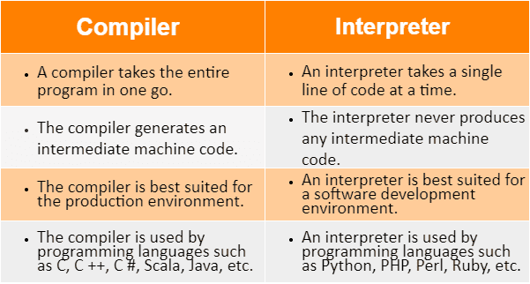

Slide 12
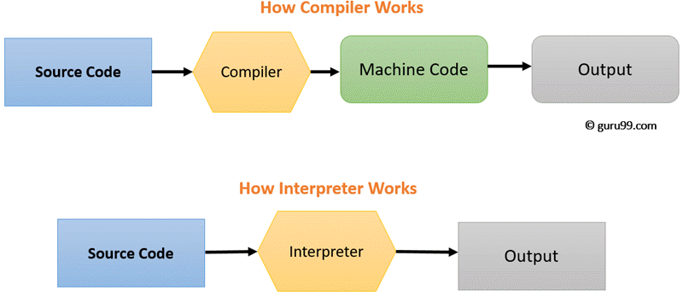

Slide 13
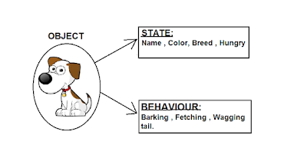
WHAT IS Object Oriented Programming ?
Python supports Object-Oriented technique of programming
Means that it can model real-world entities
Class
Object
An object has,
1. Properties (State , Attributes)
2. Behaviors (Methods) .

Slide 14
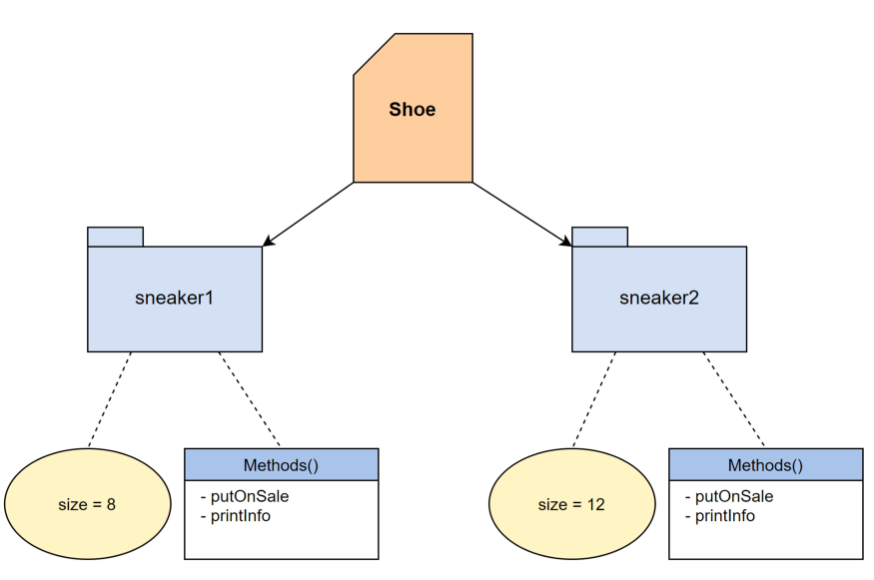
CLASS
Object
1. Properties (State , Attributes)
2. Behaviors (Methods) .

Slide 15
Python Features
Easy to learn: easy to read and easy to maintain.
Portable: It can run on various hardware platforms and has the
same interface on all platforms.
Extendable: You can add low-level modules to the Python interpreter.
Scalable: Python provides a good structure and support for large programs.
Python has support for an interactive mode of testing and debugging.
Everything in Python is an object: variables, functions, even code. Every object has an ID, a type, and a value.

Slide 16



Python Standard Library is a collection of script modules accessible to a Python program to simplify the programming process and removing the need to rewrite commonly used commands.
DATA MANAGEMENT
DATA MANAGEMENT

Slide 17
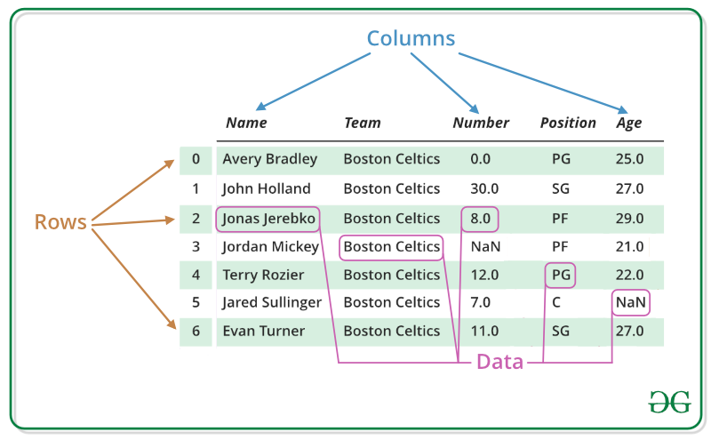
PANDAS:
“Python Data Analysis Library ”
Pandas is a Python library used for working with data sets.
It has functions for analyzing, cleaning, exploring, and manipulating data.

Slide 18
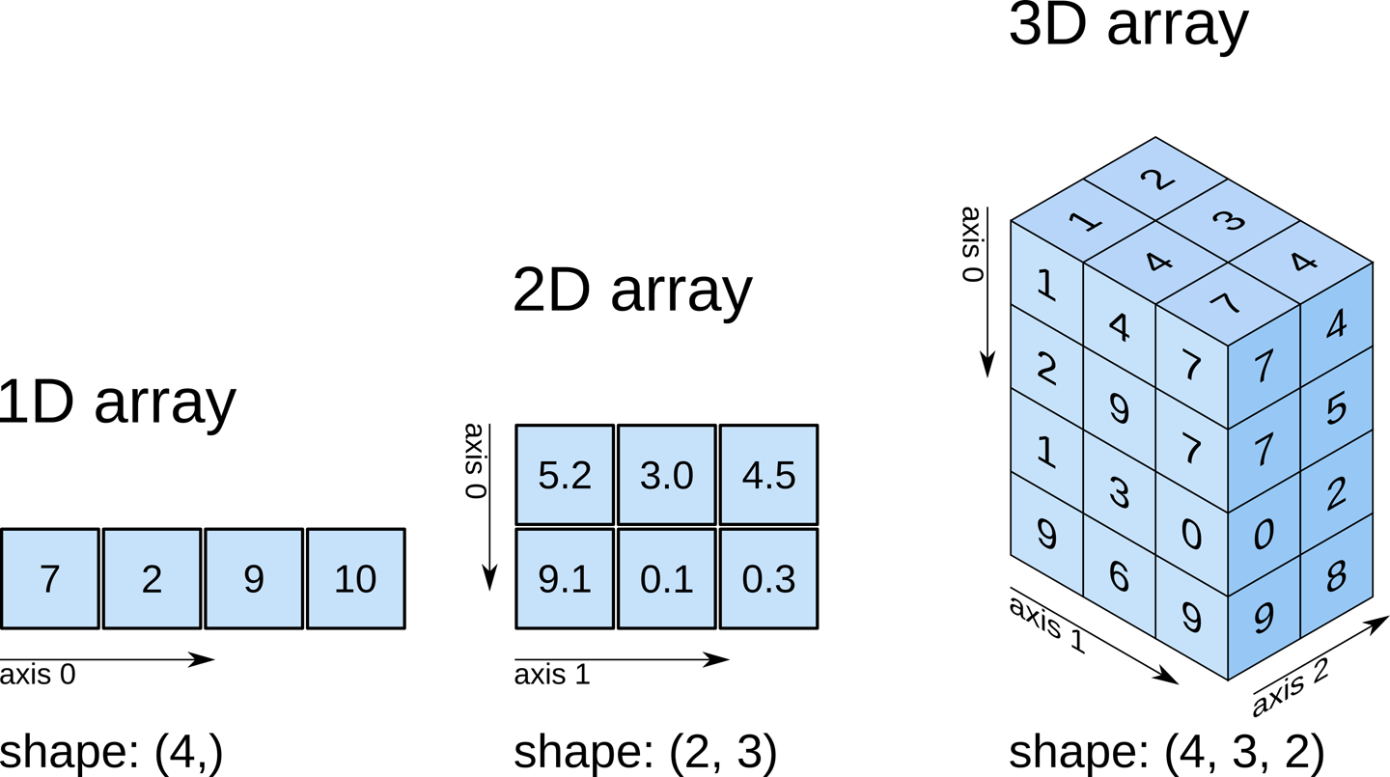
NUMPY:
NumPy contains a multi-dimensional array and matrix data structures.
It can be utilise to perform a number of mathematical operations on arrays such as trigonometric, statistical, and algebraic routines.

Slide 19
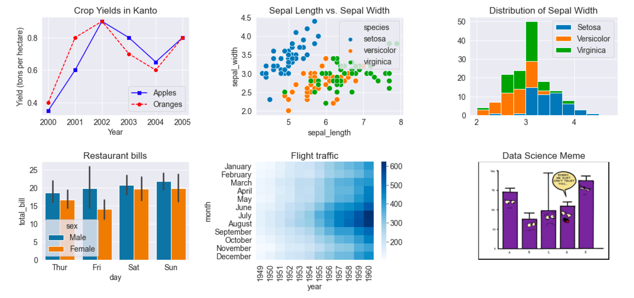
MATPLOTLIB:
Matplotlib is a low level graph plotting library in python that serves as a visualization utility.

Slide 20
FIRST PROGRAM IN PYTHON
The print() function prints the specified message to the screen,
SOURCE CODE OR INPUT
Print ("Hello", "how are you?")
OUTPUT
Hello how are you?

Slide 21

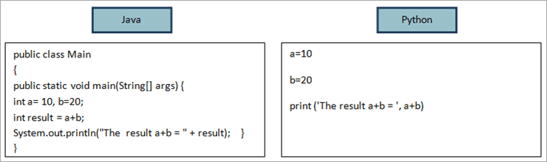


Slide 22
HISTORY OF PYTHON
Python was conceptualized by Guido Van Rossum in the late 1980s.
Rossum published the first version of Python code (0.9.0) in February 1991 at the CWI (Centrum Wiskunde & Informatica) in the Netherlands , Amsterdam.
Python is derived from ABC programming language, which is a general-purpose programming language that had been developed at the CWI.
Rossum chose the name "Python", since he was a big fan of Monty Python's Flying Circus.
Python is now maintained by a core development team at the institute, although Rossum still holds a vital role in directing its progress.

Slide 23
How to work on python ?
•A program that can read Python programming statements and execute them is the Python interpreter
•Python interpreter has two modes:
Interactive mode waits for a statement from the keyboard and executes it
Script mode reads the contents of a file (Python programor Python script) and interprets each statement in the file

Slide 24
Interpreter Mode
• Invoke Python interpreter through Windows or command line
>>> is the prompt that indicates the interpreter is waiting for a Python statement
>>> print (‘Python programming is fun!’)
Python programming is fun!
>>>
• Statements typed in interactive mode are not saved as a program

Slide 25
Script Mode
Writing Python Programs and Running Them in Script Mode
•Use a text editor to create a file containing the Python statements
•Save the file with a .py extension
•To run the program:
>>> python test.py

Slide 26
Three kinds of errors
Syntax error :
Some statement in the program is not a legal statement in the language.
Runtime error :
An error occurs while the program is executing, causing the program to terminate (divide by zero, etc.)
Logic error :
The program executes to completion, but gives incorrect results.

Slide 27
USEFUL TOOL
Python IDEs
Vim
Eclipse with PyDev
Sublime Text
Emacs
Komodo Edit
PyCharm
An integrated development environment is a software application that provides comprehensive facilities to computer programmers for software development.
An IDE normally consists of at least a source code editor, build automation tools and a debugger.

Slide 28












ORANISATIONS USE PYTHON
• Web Development : Google , Yahoo , Instagram
• Games : Battlefield 2 , Crystal Space
• Graphics : Walt Disney Feature Animation , Blender 3D
• Science : National Weather Service , NASA , Applied Maths
• Software Development : Nokia , Red Hat , IBM
• Education : University of California-Irvine , SchoolTool
• Government : The USA Central Intelligence Agency (CIA)

Slide 29
The Python Character Set
It is the set of valid characters that python understands.
Python uses the Unicode character set.
It includes numbers from numbers like
Digits: 0-9, Letters: a-z, A-Z Operators: + , - , / , * , // , ** Punctuators like : (colon) , (), {}, [] Whitespaces like space, tabs, etc

Slide 30
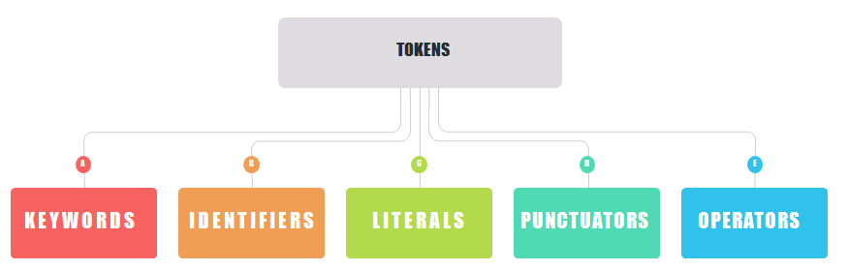
WHAT ARE TOKENS ?
Tokens are building blocks of a language.
They are the smallest individual unit of a program.
Also called lexical unit.

Slide 31
Keyword
Keywords are special words which are reserved and have a specific meaning in programming language.
All keywords in Python are case sensitive. So, you must be careful while using them in your code.
False class from or
None continue global pass
True def if raise
and del import return
as elif in try
assert else is while
async except lambda with
await finally nonlocal yield
break for not

Slide 32
identifiers
An identifier is a name given to entities like class, functions, variables, etc. It helps to differentiate one entity from another.
User-defined names.

Slide 33
Rules for writing identifiers
Identifiers can be a combination of letters in lowercase (a to z) or uppercase (A to Z) or digits (0 to 9) or an underscore _.
Names like myClass, var_1 and print_this_to_screen, all are valid example.
An identifier cannot start with a digit. 1variable is invalid, but variable1 is a valid name.
Keywords cannot be used as identifiers.
We cannot use special symbols like !, @, #, $, % etc. in our identifier.
An identifier can be of any length.

Slide 34
EXAMPLE OF IDENTIFIERS
Python Valid Identifiers Example
Let’s look at some examples of valid python identifiers.
ab10c: contains only letters and numbers
abc_DE: contains all the valid characters
_: surprisingly but Yes, underscore is a valid identifier
_abc: identifier can start with an underscore
Python Invalid Identifiers Example
Let’s look at some examples of invalid python identifiers.
99: identifier can’t be only digits
9abc: identifier can’t start with number
x+y: the only special character allowed is an underscore
for: it’s a reserved keyword

Slide 35
LITERALS
Often referred as Constant- Values
Literals are data items that have a fixed value
Python allows several kinds of literals:
String literals
Numeric literals
Boolean literals
Special literal NONE
Literal Collections

Slide 36
String literals
String literals can be forms by enclosing text in both forms quotes
i.e single quotes or double quotes
Types of Strings:
a) Single-line String- Strings that are terminated within a single-line are known as Single line Strings.
Example: text1='hello’
b) Multi-line String - A piece of text that is written in multiple lines is known as multiple lines string.
There are two ways to create multiline strings:
2) Using triple quotation marks:-
Example:
str2='''''welcome
to
SSSIT'''
print (str2)
Output: welcome
to
SSSIT
1) Adding black slash at the end of each line.
Example:
text1='hello\
user'
print(text1)
Output:
'hellouser'

Slide 37
Numeric literal
Numeric literals are those literals which can contain digits only . Types of numeric literal are:
Integer Literals
Floating Point Literals
Complex Literals
Fractional Form
Exponent Form
The real number in exponent form has two parts:
–Mantissa :- The digits before the symbol E form the Mantissa part. –Exponent :- The digits after the symbol E form the Exponent part. The exponent Part can only contain integers
Complex literals are of the form A+Bj.
Here A and B are real values. A is termed as real part and B is termed as imaginary part.
j represents square root of -1. Which is an imaginary number.
Example:
2.5+3.1j is a complex literal
1.33 х 105 can be represented as 1.33E5

Slide 38
Boolean literal
A Boolean literal can have any of the two values: True or False.
Example - Boolean Literals
x = (1 == True)
y = (2 == False)
z = (3 == True)
a = True + 10
b = False + 10
print("x is", x)
print("y is", y)
print("z is", z)
print("a:", a)
print("b:", b) is False z is False a: 11 b: 10
Output: x is True
y is False
z is False a: 11
b: 10

Slide 39
Special literal
10 Noe
Python contains one special literal i.e., None.
None is used to specify to that field that is not created. It is also used for the end of lists in Python.
Example - Special Literals
val1=10
val2=None
print(val1)
print(val2)
10 None
Output: 10
None
10 None

Slide 40
Literal collection
Python provides the four types of literal collection such as
List literals.
Tuple literals.
Dict literals.
Set literals.

Slide 41
List literal
List is a collection which is ordered and changeable. Allows duplicate members.
A list can contain different data types
Lists are used to store multiple items in a single variable
Lists are created using square brackets:
thislist = ["apple", "banana", "cherry"] print(thislist)

Slide 42
Tuple literal
Tuple is a collection which is ordered and unchangeable. Allows duplicate members.
A tuple can contain different data types
Tuples are written with round brackets.
thistuple = ("apple", "banana", "cherry") print(thistuple)

Slide 43
Dictionary literal
Dictionaries are used to store data values in key:value pairs.
Dictionaries cannot have two items with the same key
can be referred to by using the key name.
Dictionary is a collection which is ordered* and changeable. No duplicate members.
thisdict = {"brand": "Ford","model": "Mustang","year": 1964} print(thisdict)

Slide 44
Set literals
Set is a collection which is unordered and unindexed. No duplicate members.
Set items can be of any data type
Sets are written with curly brackets.
thisset={"apple", "banana", "cherry", "apple"} print(thisset)

Slide 45
OPERATORS
Operators in general are used to perform operations on values and variables in Python.
Python language supports the following types of operators.
Arithmetic Operators
Comparison(i.e., Relational) Operators
Assignment Operators
Logical Operators
Bitwise Operators
Membership Operators
Identity Operator

Slide 46
Arithmetic operator
Arithmetic operators are used with numeric values to perform common mathematical operations:
Operator | Name | Example
+ | Addition | x + y
- | Subtraction | x - y
* | Multiplication | x * y
/ | Division | x / y
% | Modulus | x % y
** | Exponentiation | x ** y
// | Floor division | x // y

Slide 47
Comparison operator
Comparison operators are used to compare two values:
Operator | Name | Example
== | Equal | x == y
!= | Not equal | x != y
> | Greater than | x > y
< | Less than | x < y
>= | Greater than or equal to | x >= y
<= | Less than or equal to | x <= y

Slide 48
Assignment operator
Assignment operators are used to assign values to variables:
Operator | Example | Same As
= | x = 5 | x = 5
+= | x += 3 | x = x + 3
-= | x -= 3 | x = x - 3
*= | x *= 3 | x = x * 3
/= | x /= 3 | x = x / 3
%= | x %= 3 | x = x % 3
//= | x //= 3 | x = x // 3
**= | x **= 3 | x = x ** 3
&= | x &= 3 | x = x & 3
|= | x |= 3 | x = x | 3
^= | x ^= 3 | x = x ^ 3
>>= | x >>= 3 | x = x >> 3
<<= | x <<= 3 | x = x << 3

Slide 49
Logical operator
Logical operators are used to combine conditional statements:
Operator | Description | Example
and | Returns True if both statements are true | x < 5 and x < 10
or | Returns True if one of the statements is true | x < 5 or x < 4
not | Reverse the result, returns False if the result is true | not(x < 5 and x < 10)

Slide 50
Bitwise operator
Binary 2 is 1 0
3 is 1 1
Bitwise operators are used to compare (binary) numbers:
Operator | Name | Description
& | AND | Sets each bit to 1 if both bits are 1
| | OR | Sets each bit to 1 if one of two bits is 1
^ | XOR | Sets each bit to 1 if only one of two bits is 1
~ | NOT | Inverts all the bits
<< | Zero fill left shift | Shift left by pushing zeros in from the right and let the leftmost bits fall off
>> | Signed right shift | Shift right by pushing copies of the leftmost bit in from the left, and let the rightmost bits fall off

Slide 51
Membership operator
Membership operators are used to test if a sequence is presented in an object:
Operator | Description | Example
in | Returns True if a sequence with the specified value is present in the object | x in y
not in | Returns True if a sequence with the specified value is not present in the object | x not in y

Slide 52
Identity operator
Identity operators are used to compare the objects, not if they are equal, but if they are actually the same object, with the same memory location:
Operator | Description | Example
is | Returns True if both variables are the same object | x is y
is not | Returns True if both variables are not the same object | x is not y

Slide 53
PUNCTUATORs
Theses are symbols that are used in programming languages to organize programming- sentence structures and indicate the rhythm and emphasis of statements, expressions and program structure.
Example : ‘ “ # \ ( ) { } [ ] @ : , =

Slide 54
BAREBONES OF A PYTHON PROGram
EXPRESSIONS: An Expression is any legal combination of symbols that represents a value
EXAMPLE: a+3 , b<5 ,15
STATEMENT : An Statement is a programming instruction that does something i.e , some action takes place
COMMENTS: Comments are the additional readable information to clarify the source code comments in python begin with #
FUNCTIONS: A Function is a code that has a name and it can be reused (executed again) by specifying its name in program ,where needed
BLOCKS AND INDENTATION : a group of individual statements are called as Block or code-block or suite

Slide 55
DYNAMIC TYPing
A variable pointing of a certain type , can be made to point to a value of different type . This is called DYNAMIC TYPING
X = 25
print(x)
X = “python”
print(x)

Slide 56
STATEMENTS IN PYTHON
Instructions that a Python interpreter can execute are called statements. For example, a = 1 is an assignment statement. if statement, for statement, while statement, etc. are other kinds of statements.
Empty Statement
Simple Statement (Single Statement)
Compound Statement

Slide 57
Empty Statement
A statement that does nothing. In Python an empty statement is pass statement.
It takes the following form:
Pass
Whenever Python encounters a pass statement, Python does nothing and moves to next statement in the flow of control.
Simple Statement
Any executable statement is a simple statement in Python.
For example: Name=input(“enter your name”) Compound Statement A compound statement represents a group of statements executed as a unit.
compound statement
In Python are written in a specific pattern .
It has :
-> A header line which begins with a keyword and ends with a colon.
-> A body consisting of one or more Python statements, each indented inside the header line.

Slide 58
Program Logic Development Tools:
Before developing the solution of a problem in terms of a program, you should read and analyze the given problem and decide about basic sub tasks needed to solve a problem and the order of these subtasks.
The various logic development tools are:
Flowcharts
Pseudocode
Decision Tree
ALGORITHM

Slide 59
Algorithm :
An Algorithm is a step by step procedure to solve a given problem.
For example,
An algorithm for determining average of two numbers:
Step-1: Start
Step-2: Input two numbers in variable num1 & num2
Step-3: Average= (num1+num2)/2
Step-4: Print the value of Average
Step-5: Stop
It is a set of ordered and finite steps to solve a given problem

Slide 60

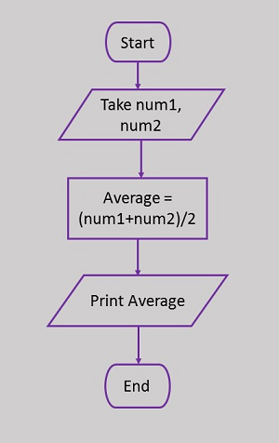






Flowchart:
A flowchart is a graphical representation of an algorithm.
A flowchart shows different subtasks with different symbols. Some commonly used flowchart symbols are :
example:
Symbol | Symbol Name | Purpose
 | Start/Stop | Used at the beginning and end of the algorithm to show start and end of the program.
 | Process | Indicates processes like mathematical operations.
 | Input/ Output | Used for denoting program inputs and outputs.
 | Decision | Stands for decision statements in a program, where answer is usually Yes or No.
 | Arrow | Shows relationships between different shapes.
 | On-page Connector | Connects two or more parts of a flowchart, which are on the same page.
 | Off-page Connector | Connects two parts of a flowchart which are spread over different pages.

Slide 61
Pseudocode:
Pseudo code is an informal way of programming description that does not require any strict programming language syntax or underlying technology considerations.
Pseudo Code for determining average of two numbers:
Start
Input two numbers in variable num1 & num2
Average= (num1+num2)/2
Print the value of Average
Stop
It is used for creating an outline or a rough draft of a program.
Pseudo code is not an actual programming language. So it cannot be compiled into an executable program.
It uses short terms or simple English language syntaxes to write code for programs before it is actually converted into a specific programming language.
The purpose of using pseudo code is an efficient key principle of an algorithm.
It is used in planning an algorithm with sketching out the structure of the program before the actual coding takes place.

Slide 62
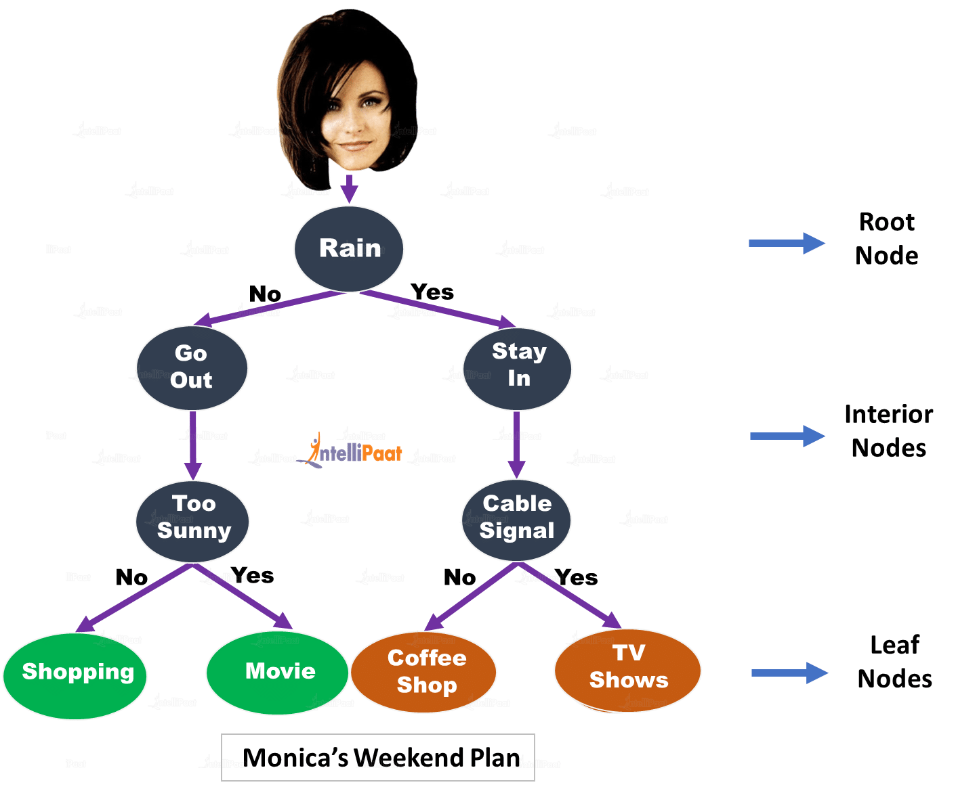
Decision Tree:
An decision tree is a tool to represent a hierarchical structure of outcomes based on certain rules
Root Node: This node gets divided into different homogeneous nodes. It represents entire sample.
Splitting: It is the process of splitting or dividing a node into two or more sub-nodes.
Interior Nodes: They represent different tests on an attribute.
Branches: They hold the outcomes of those tests.
Leaf Nodes: When the nodes can’t be split further, they are called leaf nodes.
Parent and Child Nodes: The node from where sub-nodes are created is called a parent node. And, the sub-nodes are called the child nodes.

Slide 63
Statement Flow Control :
Every programming language provides constructs to support
Sequential - default mode
Selection - used for decisions and branching
Repetition - used for looping, i.e., repeating a piece of code multiple times.
A program’s control flow is the order in which the program’s code executes.

Slide 64
1. Sequential
Sequential statements are a set of statements whose execution process happens in a sequence.
The problem with sequential statements is that if the logic has broken in any one of the lines, then the complete source code execution will break.
a=20
b=10
c=a-b
print("Subtraction is : ",c)

Slide 65
2. Selection/Decision control statements
In Python, the selection statements are also known as Decision control statements or branching statements.
The selection statement allows a program to test several conditions and execute instructions based on which condition is true.
Some Decision Control Statements are:
if
if-else
if-elif-else
nested if

Slide 66
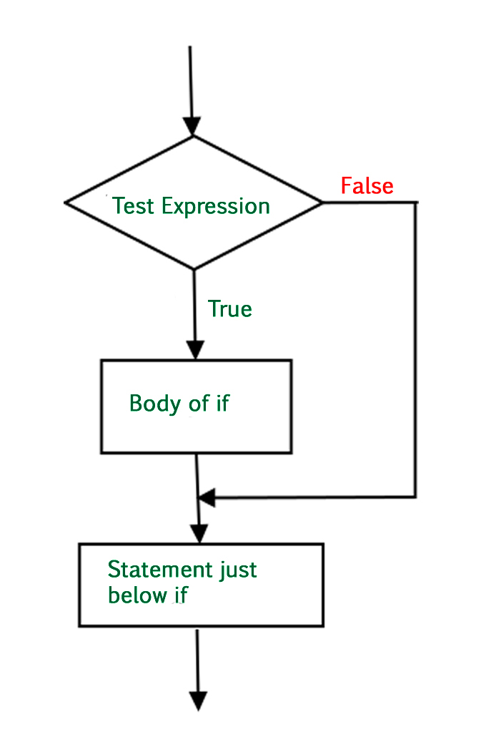
if
Syntax :
if (condition) :
statement
Example 1:
if grade==’A’:
print(“well done”)
Example 2:
if a>b :
print(“A has more than B has”)

Slide 67
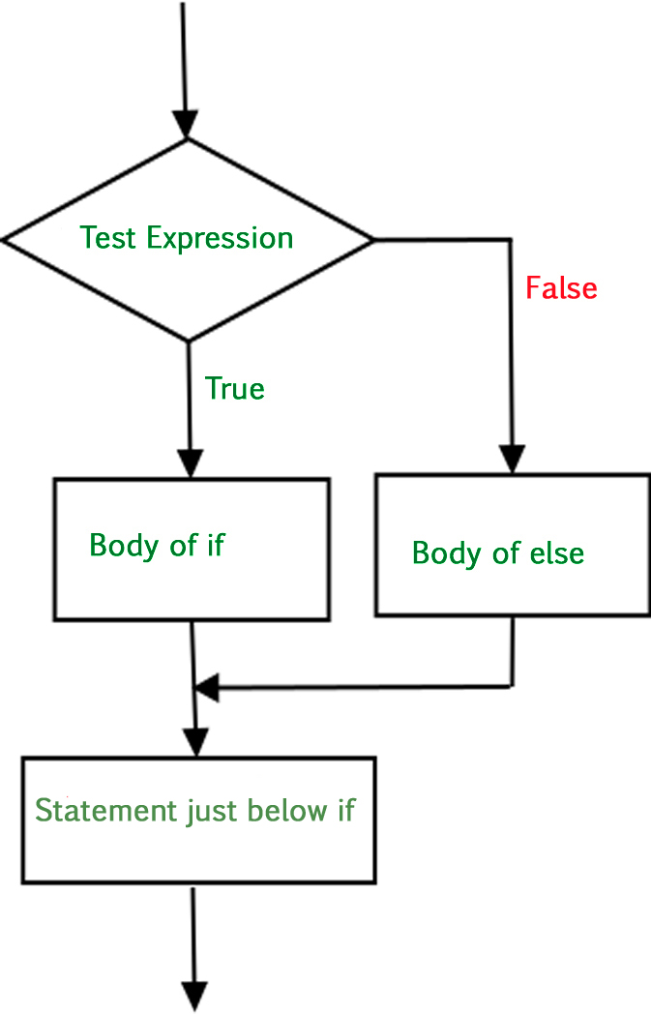
If-else
Syntax :
if (condition):
# Executes this block
# condition is true
else:
# Executes this block
# condition is false
Example 1:
i = 2
if (i < 15):
print ("i is smaller than 15") else:
print ("i is greater than 15")

Slide 68
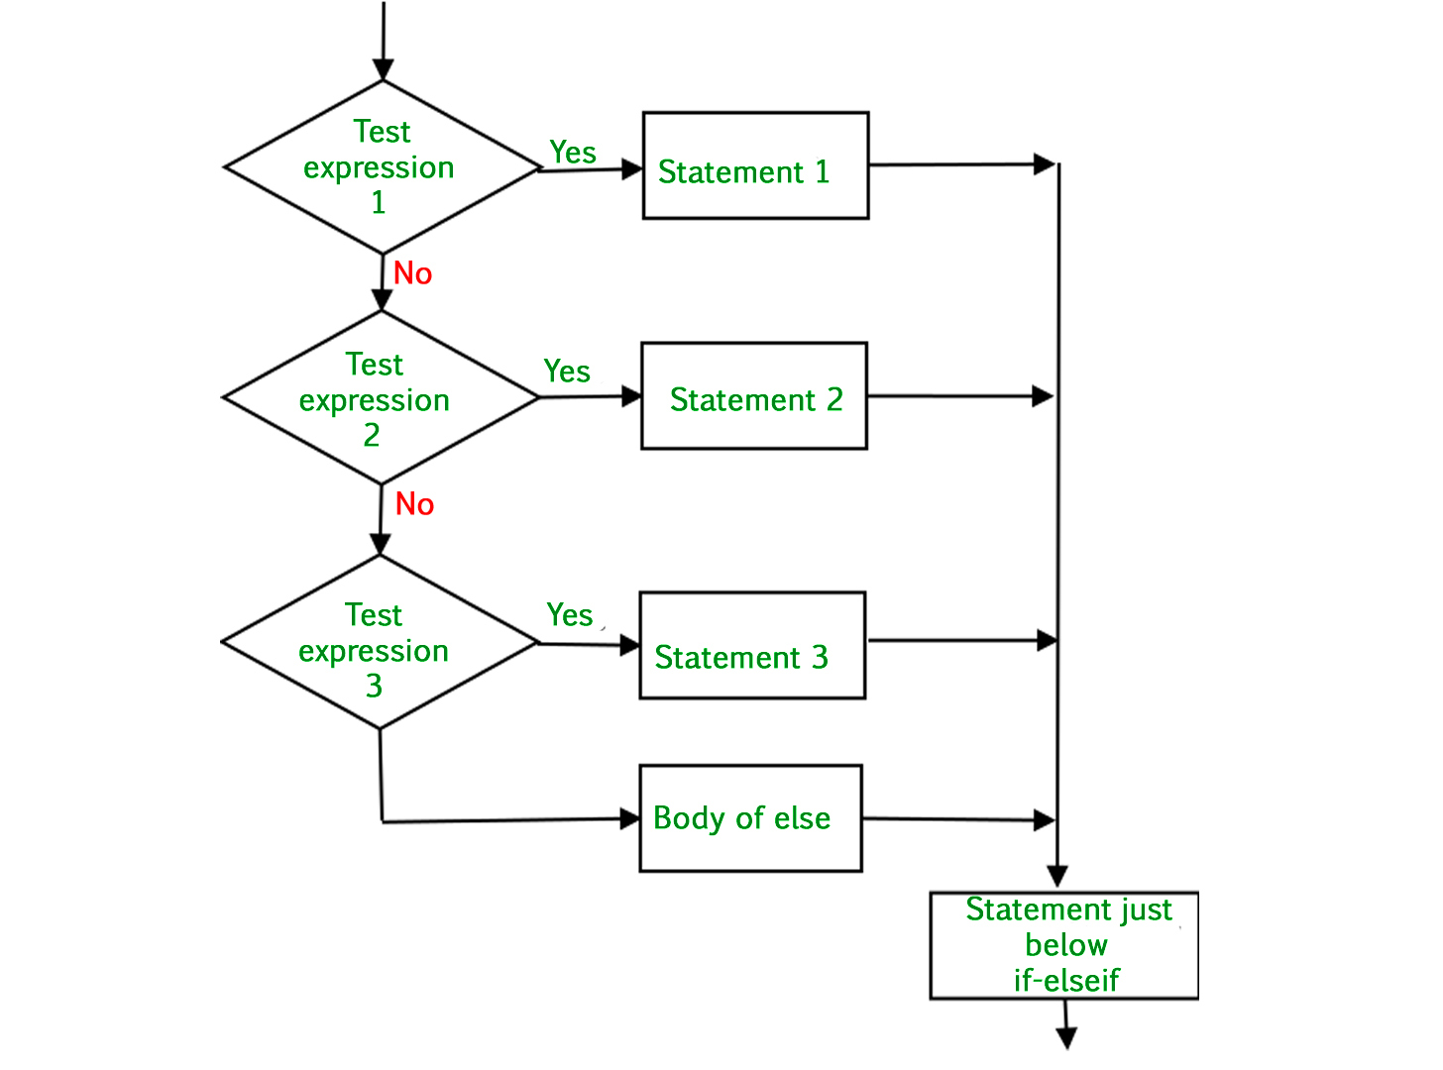
If-elif-else
Syntax :
if (condition):
#statement
elif (condition):
#statement
.
.
else:
#statement
Example 1:
i = 20
if (i == 10):
print ("i is 10")
elif (i == 15):
print ("i is 15")
elif (i == 20):
print ("i is 20")
else:
print ("i is not present")

Slide 69
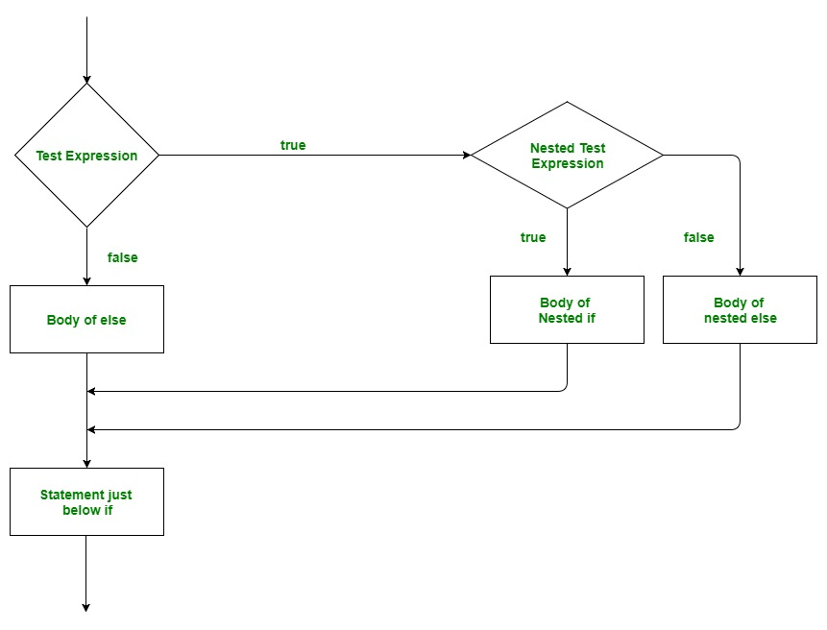
Nested if
Nested if statements means an if statement inside another if statement.
Syntax :
if (condition1):
# Executes when condition1 is true
if (condition2):
# Executes when condition2 is true
# if Block is end here
# if Block is end here
num = float(input("Enter a number: "))
if (num >= 0):
if (num == 0):
print("Zero")
else:
print("Positive number")
else:
print("Negative number")

Slide 70
3. Repetition/Iteration
A repetition statement is used to repeat a group(block) of programming instructions until a certain condition fulfilled.
In Python, we generally have two loops/repetitive statements:
for loop
The loops that repeat a certain number of times
COUNTING LOOPS
while loop
The loops that repeat until a certain thing happens i.e the keep repeating as long as some condition is true
CONDITIONAL LOOPS

Slide 71
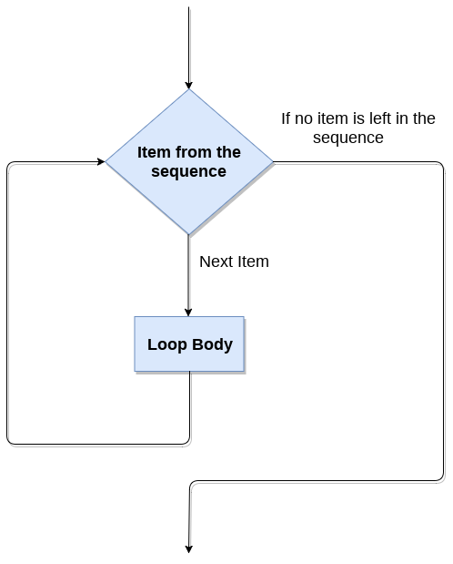
for LOOP
Each time , when the loop-body is executed ,is called an Itertion
Syntax:
for iterating_var in sequence:
statements_to_repeat
str = "Python"
for i in str:
print(i)

Slide 72
range( )
The range() function is used to generate the sequence of the numbers.
Syntax:
for iterating_var in range(start,end,step_size) :
statements
start: Starting number of the sequence.
stop: Generate numbers up to, but not including this number.
step(Optional): Determines the increment between each numbers in the sequence.
for i in range(1,11,1):
print(i)

Slide 73
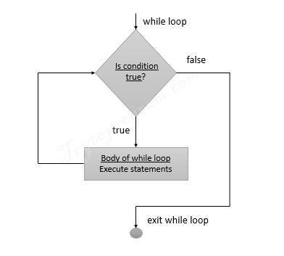
while LOOP
while loop keeps reiterating a block of code defined inside it until the desired condition is met.
Syntax:
while(condition):
statement
i = 1
while (i < 10):
print (i)
i = i+1

Slide 74
Jump statements are used to transfer the program's control from one location to another.
Means these are used to alter the flow of a loop like - to skip a part of a loop or terminate a loop
There are three types of jump statements used in python.
1.break
2.continue
3.pass

Slide 75
break statement
Terminates the loop statement and transfers execution to the statement immediately following the loop
for val in "string " :
if val == "I" :
break
print(val)
print("The end")

Slide 76
continue statement
Causes the loop to skip the remainder of its body and immediately retest its condition prior to reiterating.
for val in "init" :
if val == "i" :
continue
print(val)
print("The end")

Slide 77
pass statement
The pass statement in Python is used when a statement is required syntactically but you do not want any command or code to execute.
for i in 'initial’:
if(i == 'i’):
pass
else:
print(i)

Slide 78
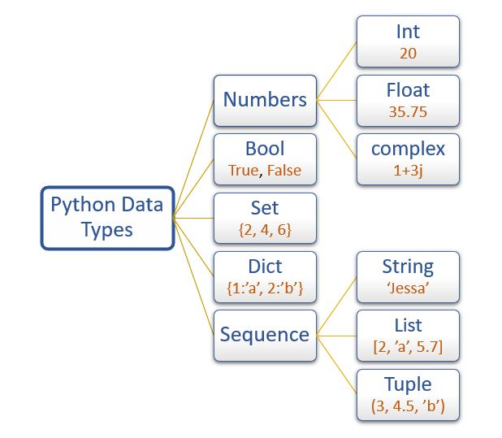
DATA TYPE
A data type is a characteristic that tells the interpreter how a programmer intends to use the data.
The data type of any object is found using the built in
type() function.

Slide 79
python data types can be broadly classified into two categories:
Immutable type
Mutable type.
An object whose internal state can be changed is called a mutable object
An object whose internal state cannot be changed is called an immutable object.
List
Set
Dictionary
Boolean
Numeric
String
Tuple

Slide 80
STRING LIST DICTIONARY
MANIPULATION ON

Slide 81
STRING
MANIPULATION ON

Slide 82
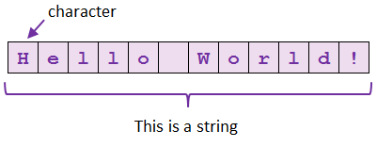
STRING
Sequence of characters in quotes
my_string = "This is a string"
my_string2 = 'This is also a string'
Assign String to a Variable
Assigning a string to a variable is done with the variable name followed by an equal sign and the string:
a = "Hello World!" print(a)
String Length
The length of a string represents the number of characters it contains.
To get the length of a string, use the len() function.
a = "Hello World!" print(len(a))

Slide 83
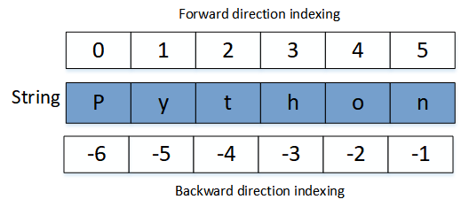
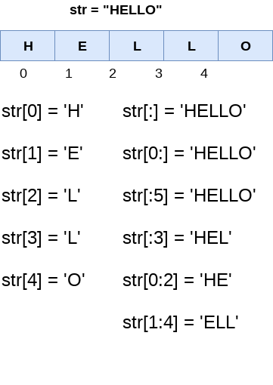
POSITION OF CHARACTER IN STRING
A character (also called element) of a string can be accessed with it's index number.
SlICING OF STRING
We can return a range of characters by using the slice syntax.
string[start:end:step]

Slide 84
TRAVERSING A STRING
Traversing refers to iterating through the elements of a string, one character each time.
name = “superb" for ch in name:
print(ch,‘-’,end=‘ ’)
Strings are immutable. This means that elements of a string cannot be changed once they have been assigned.
>>> my_string = ‘class11’
>>> my_string[5] = 'a’
TypeError: 'str' object does not support item assignment

Slide 85
String Special Operators
Traversing refers to iterating through the elements of a string, one character each time.
a=“comp”
B=“sc”
+ Concatenation – to add two strings a + b comp sc
* Replicate same string multiple times (Repetition) a*2 compcomp
[] Character of the string a[1] will give o
[ : ] Range Slice –Range string a[1:4] will give omp
In Membership check p in a will give 1
not in Membership check for non availability M not in a will give 1

Slide 86
STRING METHOD and FUNCTION
stringObject.methodName()
Built-in String Functions in Python

Slide 87
Conversion Functions
capitalize() – Returns the string with the first character capitalized
and rest of the characters in lower case.
lower() – Converts all the characters of the String to
lowercase
upper() – Converts all the characters of the String to
uppercase
swapcase() – Swaps the case of every character in the
String means that lowercase characters got converted to uppercase and vice-versa.
title() – Returns the ‘titlecased’ version of String, which means that all words start with uppercase and the rest of the characters in words are in lowercase.
count( str[, beg [, end]]) – Returns the number of times substring ‘str’ occurs in the range [beg, end] if beg and end index are given else the search continues in full String Search is case-sensitive.

Slide 88
Comparison Functions
isalpha() – Returns ‘True’ if String contains at least one character (non-empty String), and all the characters are alphabetic, ‘False’ otherwise.
isupper() – Returns ‘True’ if all the characters in the String are in uppercase. If any of the char is in lowercase, it will return False.
islower() – Returns ‘True’ if all the characters in the String are
in lowercase. If any of the char is in uppercase, it will return False.
isalnum() – Returns ‘True’ if String contains at least one character (non-empty String), and all the characters are either alphabetic or decimal digits, ‘False’ otherwise.

Slide 89
Comparison Functions
isalnum() – Returns ‘True’ if String contains at least one character (non-empty String), and all the characters are either alphabetic or decimal digits, ‘False’ otherwise.
isdigit() – this method returns True if the string contains only numeric digits(0 to 9) else returns False
isspace() – Returns ‘True’ if there are only whitespace character in the string.

Slide 90
Padding Functions
rjust(width,fillchar) – Returns string filled with input char while pushing the original content on the right side.
By default, the padding uses a space. Otherwise, ‘fillchar’ specifies the filler character.
ljust(width,fillchar) – Returns a padded version of String with the original String left-justified to a total of width columns
By default, the padding uses a space. Otherwise, ‘fillchar’ specifies the filler character.
center(width,fillchar) – Returns string filled with the input char while pushing the original content into the center.
By default, the padding uses a space. Otherwise, ‘fillchar’ specifies the filler character.
zfill(width) – Returns string filled with the original content padded on the left with zeros so that the total length of String becomes equal to the input size.
If there is a leading sign (+/-) present in the String, then with this function, padding starts after the symbol, not before it.

Slide 91
Search Functions
find(str [,i [,j]]) – Searches for ‘str’ in complete String (if i and j not defined) or in a sub-string of String (if i and j are defined).This function returns the index if ‘str’ is found else returns ‘-1’.
index(str[,i [,j]]) – This is same as ‘find’ method. The only difference is that it raises the ‘ValueError’ exception if ‘str’ doesn’t exist.
rfind(str[,i [,j]]) – This is same as find() just that this function returns the last index where ‘str’ is found. If ‘str’ is not found, it returns ‘-1’.
count(str[,i [,j]]) – Returns the number of occurrences of substring ‘str’ in the String. Searches for ‘str’ in the complete String (if i and j not defined) or in a sub-string of String (if i and j are defined).
Where: i=search starts from this index, j=search ends at this index.

Slide 92
String Substitution Functions
replace(old,new[,count]) – Replaces all the occurrences of substring ‘old’ with ‘new’ in the String.
If the count is available, then only ‘count’ number of occurrences of ‘old’ will be replaced with the ‘new’ var.
Where old =substring to replace, new =substring
split([sep[,maxsplit]]) – Returns a list of substring obtained after splitting the String with ‘sep’ as a delimiter.
Where, sep= delimiter, the default is space, maxsplit= number of splits to be done
splitlines(num) – Splits the String at line breaks and returns the list after removing the line breaks.
Where num = if this is a positive value. It indicates that line breaks will appear in the returned list.
join(seq) – Returns a String obtained after concatenating the sequence ‘seq’ with a delimiter string.
Where: the seq= sequence of elements to join

Slide 93
MISC String Functions
lstrip([chars]) – Returns a string after removing the characters from the beginning of the String.
Where: Chars=this is the character to be trimmed from the String.
The default is whitespace character.
rstrip() – Returns a string after removing the characters from the End of the String.
Where: Chars=this is the character to be trimmed from the String. The default is whitespace character.
rindex(str[,i [,j]]) – Searches for ‘str’ in the complete String (if i and j not defined) or in a sub-string of String (if i and j are defined). This function returns the last index where ‘str’ is available.
If ‘str’ is not there, then it raises a ValueError exception.
Where: i=search starts from this index, j=search ends at this index.
len(string) – Returns the length of given String

Slide 94
LIST
MANIPULATION ON

Slide 95
LIST
A list in Python is used to store the sequence of various types of data.
Python lists are mutable type its mean we can modify its element after it created.
thislist = ["apple", "banana", "cherry"]
It can have any number of items and they may be of different types (integer, float, string etc.).
Characteristics of Lists:
The lists are ordered.
The element of the list can access by index.
The lists are the mutable type.
The lists are mutable types.
A list can store the number of various elements.

Slide 96
# empty list
my_list = []
# list of integers
my_list = [1, 2, 3]
# list with mixed data types
my_list = [1, "Hello", 3.4]

Slide 97
A list can also have another list as an item. This is called a nested list.
my_list = ["mouse", [8, 4, 6], ['a']]
Access Items in LIST
List items are indexed and you can access them by referring to the index number
thislist = ["apple", "banana", "cherry"] print(thislist[1])

Slide 98
Range of Indexes
we can specify a range of indexes by specifying where to start and where to end the range.
thislist = ["apple", "banana", "cherry", "orange", "kiwi", "melon", "mango"]
print(thislist[2:5])
thislist = ["apple", "banana", "cherry", "orange", "kiwi", "melon", "mango"] print(thislist[:4])
thislist = ["apple", "banana", "cherry", "orange", "kiwi", "melon", "mango"] print(thislist[2:])
Range of Negative Indexes
thislist = ["apple", "banana", "cherry", "orange", "kiwi", "melon", "mango"] print(thislist[-4:-1])

Slide 99
Basic List Operations
Python Expression | Results | Description
len([1, 2, 3]) | 3 | Length
[1, 2, 3] + [4, 5, 6] | [1, 2, 3, 4, 5, 6] | Concatenation
['Hi!'] * 4 | ['Hi!', 'Hi!', 'Hi!', 'Hi!'] | Repetition
3 in [1, 2, 3] | True | Membership
for x in [1, 2, 3]: print x, | 1 2 3 | Iteration

Slide 100
Python has a set of built-in methods that you can use on lists
Method | Description
append() | Adds an element at the end of the list
clear() | Removes all the elements from the list
copy() | Returns a copy of the list
count() | Returns the number of elements with the specified value
extend() | Add the elements of a list (or any iterable), to the end of the current list
index() | Returns the index of the first element with the specified value
insert() | Adds an element at the specified position
pop() | Removes the element at the specified position
remove() | Removes the first item with the specified value
reverse() | Reverses the order of the list
sort() | Sorts the list

Slide 101
Python List Built-in functions
cmp(list1, list2) | It compares the elements of both the lists. | This method is not used in the Python 3 and the above versions.
len(list) | It is used to calculate the length of the list. | L1 = [1,2,3,4,5,6,7,8] print(len(L1))
max(list) | It returns the maximum element of the list. | L1 = [12,34,26,48,72] print(max(L1)) 72
min(list) | It returns the minimum element of the list. | L1 = [12,34,26,48,72] print(min(L1)) 12
list(seq) | It converts any sequence to the list. | str = "Johnson" s = list(str) print(type(s)) <class list>

Slide 102
Dictionary

Slide 103
Python - Dictionary
Each key is separated from its value by a colon (:), the items are separated by commas, and the whole thing is enclosed in curly braces. An empty dictionary without any items is written with just two curly braces, like this: {}.
keys must be of immutable type (string, number or tuple with immutable elements) and must be unique.
dict = {'Name': 'Zara', 'Age': 7, 'Class': 'First'}

Slide 104
Dictionary Items
Dictionary items are ordered, changeable, and does not allow duplicates.
Dictionary items are presented in key:value pairs, and can be referred to by using the key name.
Access Dictionary Items
You can access the items of a dictionary by referring to its key name, inside square brackets:
thisdict = { "brand":"Ford" , "model":"Mustang", "year":1964}
print(thisdict["brand"])

Slide 105
The keys() method will return a list of all the keys in the dictionary.
The values() method will return a list of all the values in the dictionary.
thisdict = {"brand": "Ford", "model": "Mustang", "year": 1964}
x = thisdict.values()
y= thisdict.keys()
print(x)
print(y)

Slide 106
Change Values
You can change the value of a specific item by referring to its key name:
thisdict = { "brand": "Ford", "model": "Mustang", "year": 1964 } thisdict["year"] = 2018

Slide 107
Adding Items
Adding an item to the dictionary is done by using a new index key and assigning a value to it:
thisdict = { "brand": "Ford", "model": "Mustang", "year": 1964 } thisdict["color"] = "red" print(thisdict)

Slide 108
Loop Through a Dictionary
thisdict = { "brand":"Ford" , "model":"Mustang", "year":1964}
There are multiple ways to iterate over a dictionary in Python.
Iterate through all keys
Iterate through all values
Iterate through all key, value pairs
for x in thisdict.keys(): print(x)
for x in thisdict.values(): print(x)
Loop through both keys and values, by using the items() method
for x, y in thisdict.items(): print(x, y)

Slide 109
Dictionary Methods
Python has a set of built-in methods that you can use on dictionaries.
Method | Description
clear() | Removes all the elements from the dictionary
copy() | Returns a copy of the dictionary
fromkeys() | Returns a dictionary with the specified keys and value
get() | Returns the value of the specified key
items() | Returns a list containing a tuple for each key value pair
keys() | Returns a list containing the dictionary's keys
pop() | Removes the element with the specified key
popitem() | Removes the last inserted key-value pair
setdefault() | Returns the value of the specified key. If the key does not exist: insert the key, with the specified value
update() | Updates the dictionary with the specified key-value pairs
values() | Returns a list of all the values in the dictionary

